Slide 1


Fedora on Steam Deck
Michal Konečný
Senior Software Engineer
mkonecny@redhat.com
https://zlopez.github.io/
@Zlopez:matrix.org
Extra icons:

Slide 2
Agenda
Steam Deck
Installation of Fedora on Steam Deck
Using Fedora on Steam Deck

Slide 3
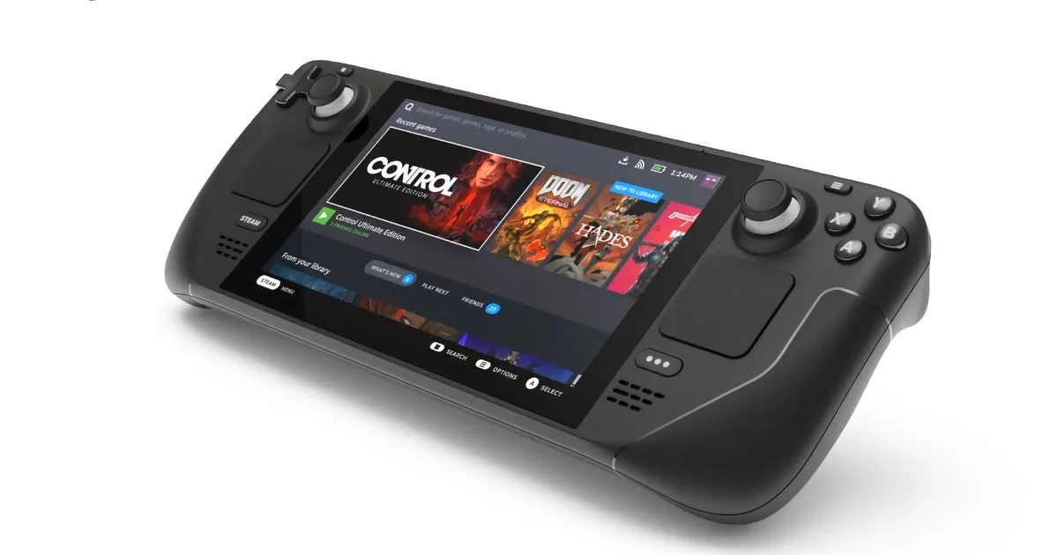
Steam Deck
Gaming handheld developed by Valve Corporation
Custom AMD APU (Zen 2)
64/256/512 GB NVMe
Steam Deck verified program

Slide 4
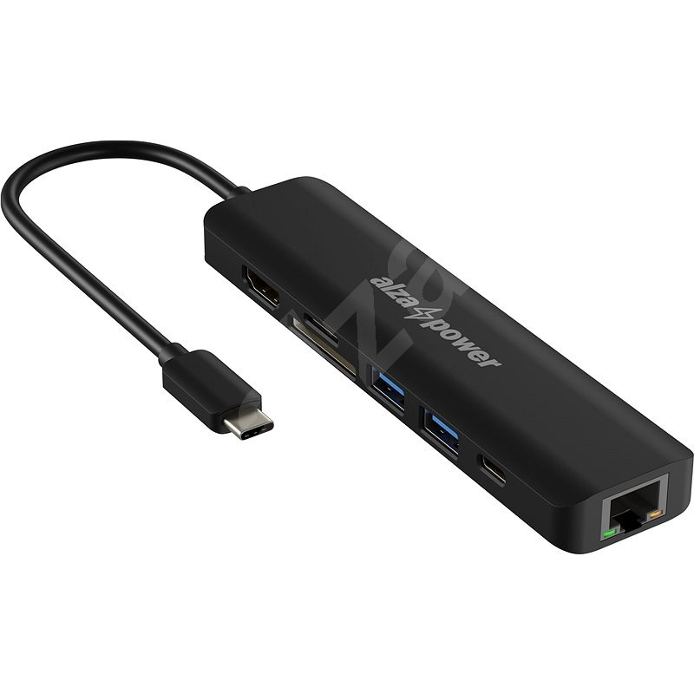
Installation of Fedora on Steam Deck
Docking station
AlzaPower USB-C Dock Station 7v1
Power delivery 60W+
Notes:
Docking station output 100 W
Charger 65W
USB-C cable 100W

Slide 5

Installation of Fedora on Steam Deck
Fedora edition
Fedora 36 Silverblue

Slide 6
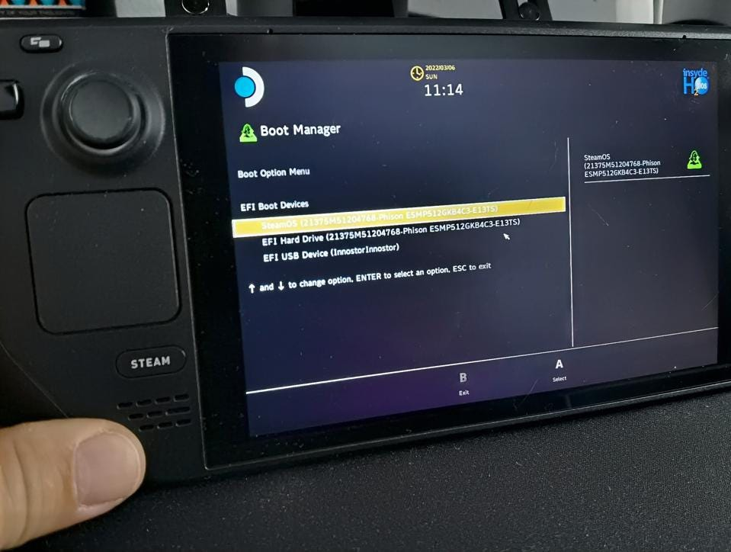
Notes:
Hold Volume Down during powering up, when you hear a chime release the Volume Down button

Slide 7
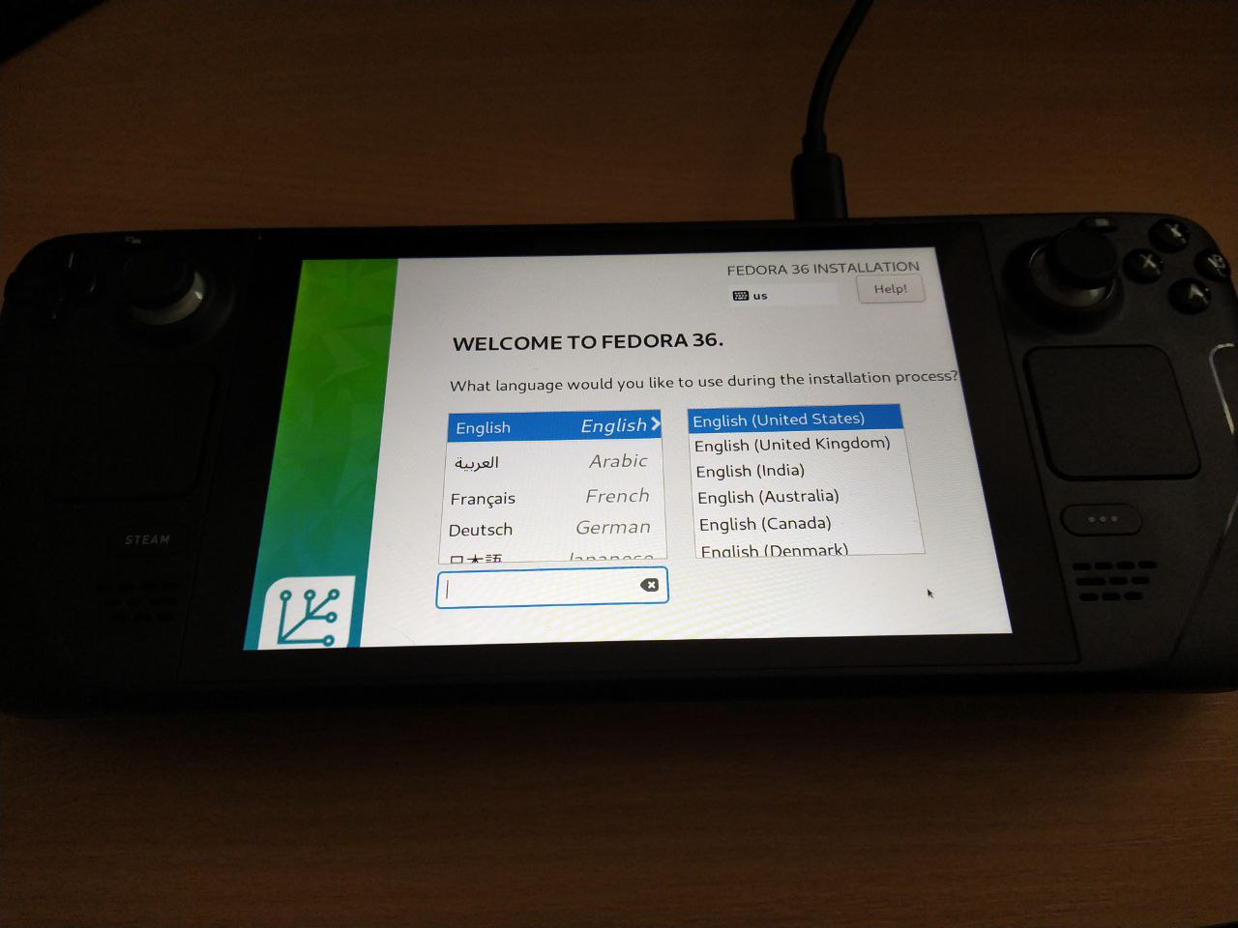
Notes:
The resolution is not supported by Anaconda

Slide 8
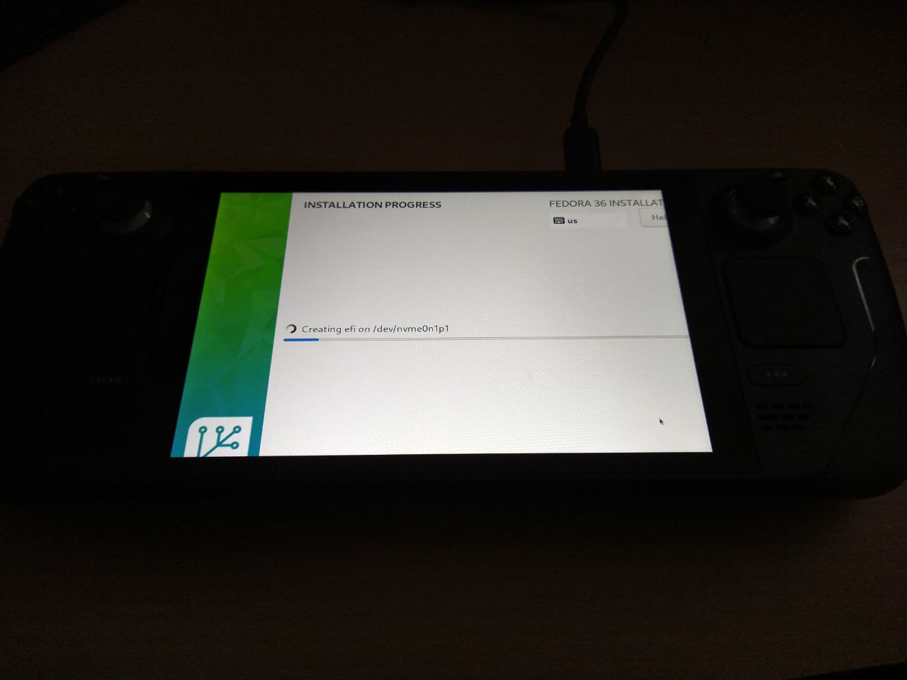
Notes:
The resolution is not supported by Anaconda

Slide 9
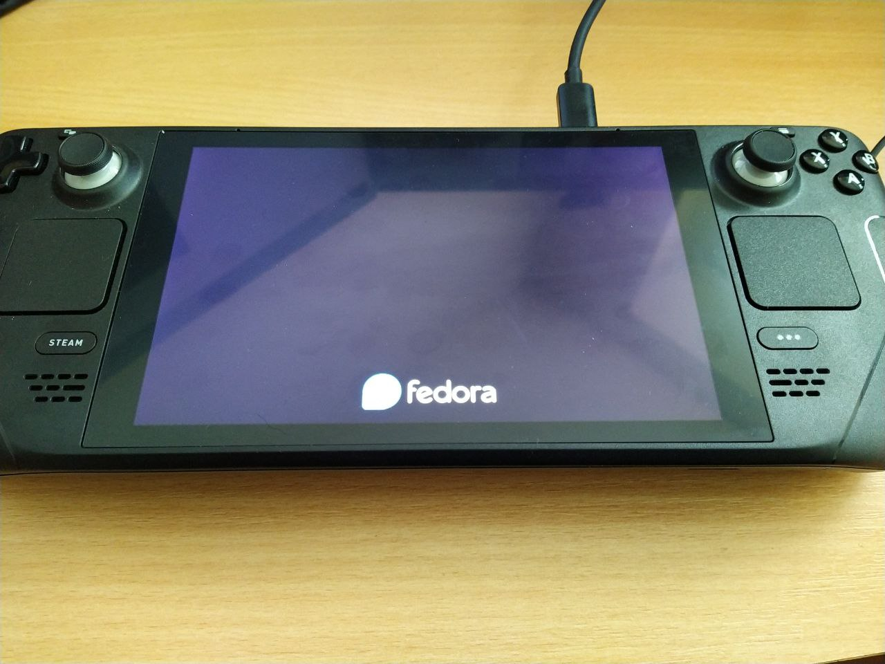

Slide 10
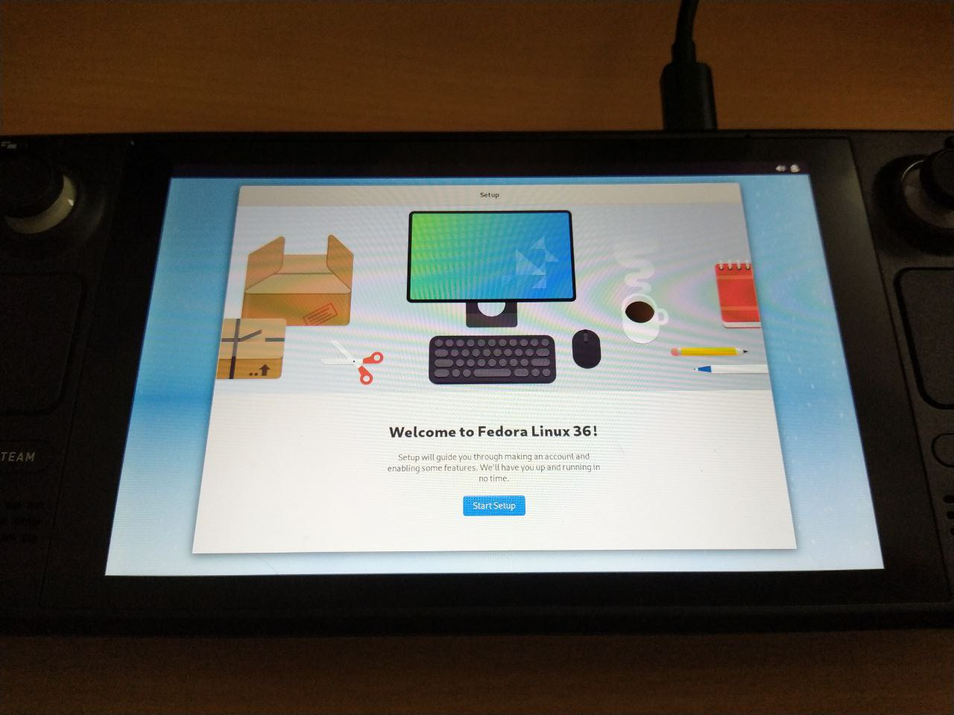

Slide 11
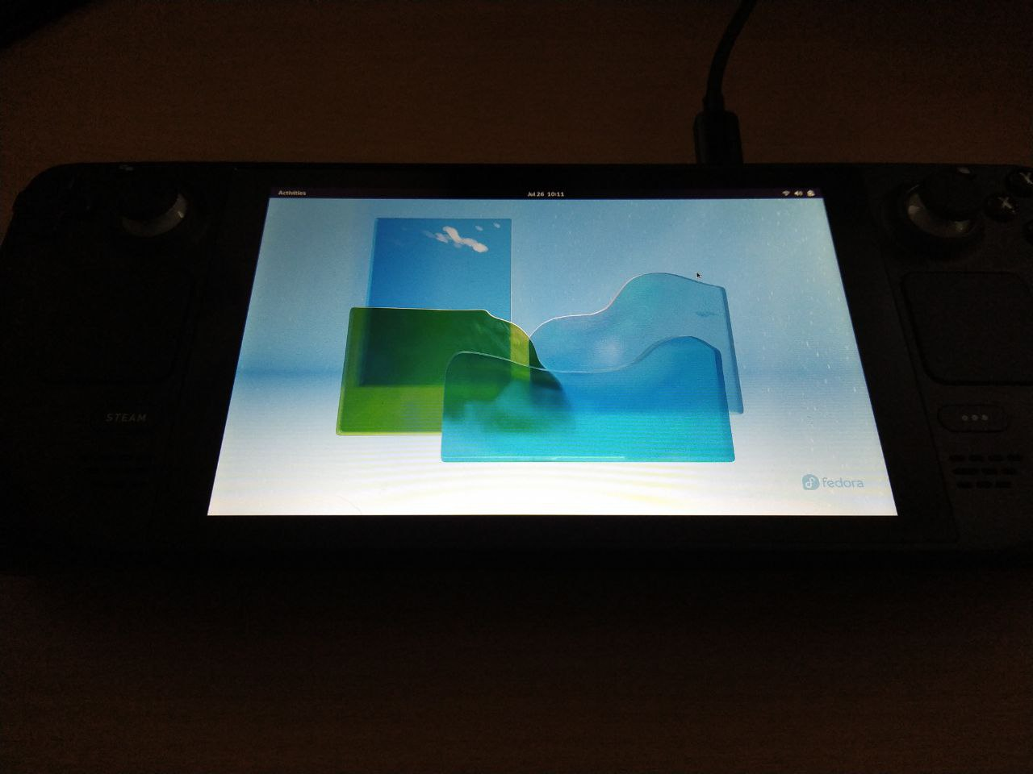


Using Fedora on Steam Deck
First run
Docking station
Resolution
Battery indicator
Sound
Fan

Slide 12
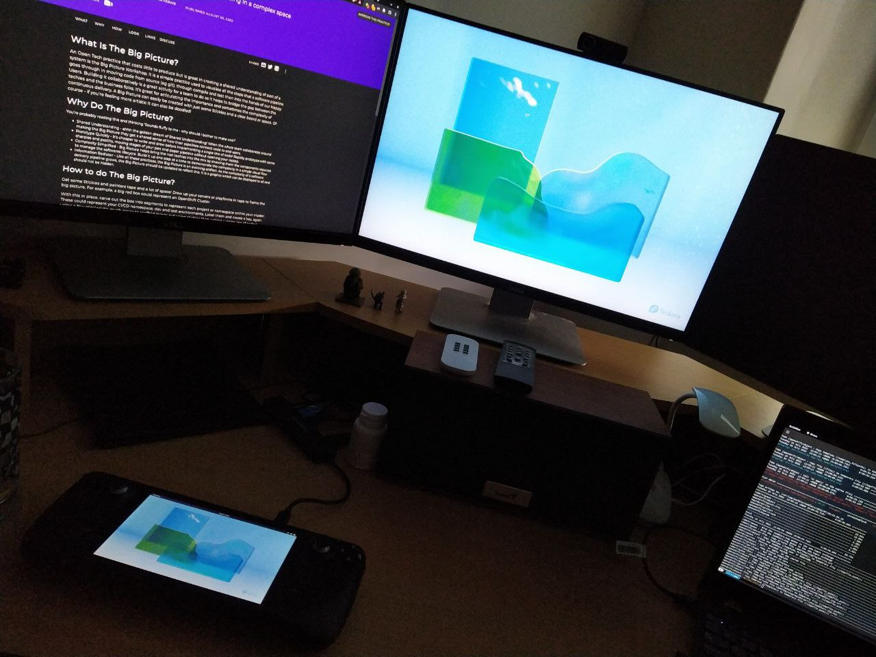
Using Fedora on Steam Deck
External peripherals
Mouse/keyboard
Monitor
Notes:
The built-in display sometimes stay black after start, but it’s still registered by GNOME

Slide 13
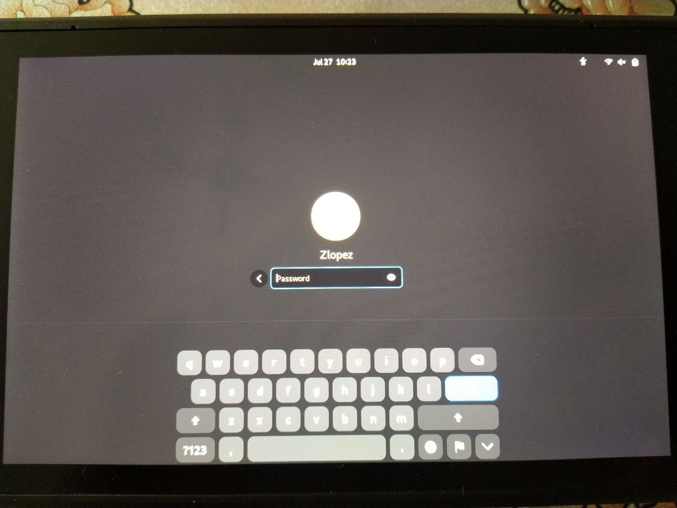
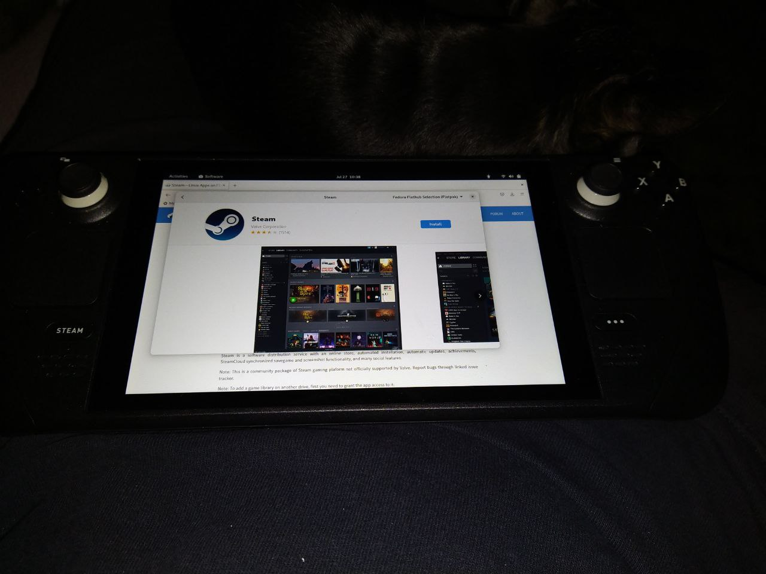
Using Fedora on Steam Deck
Without docking station
On screen keyboard
Touchpad
Touchscreen

Slide 14
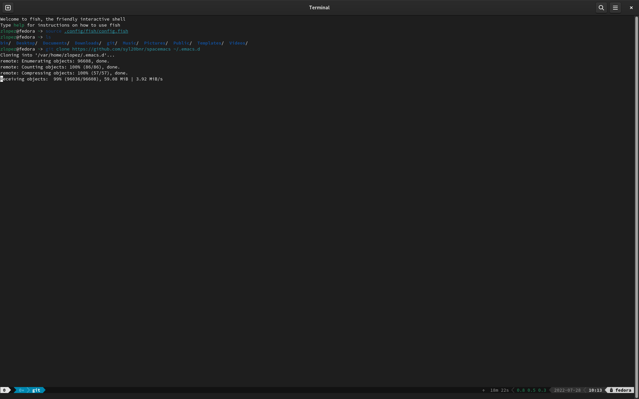
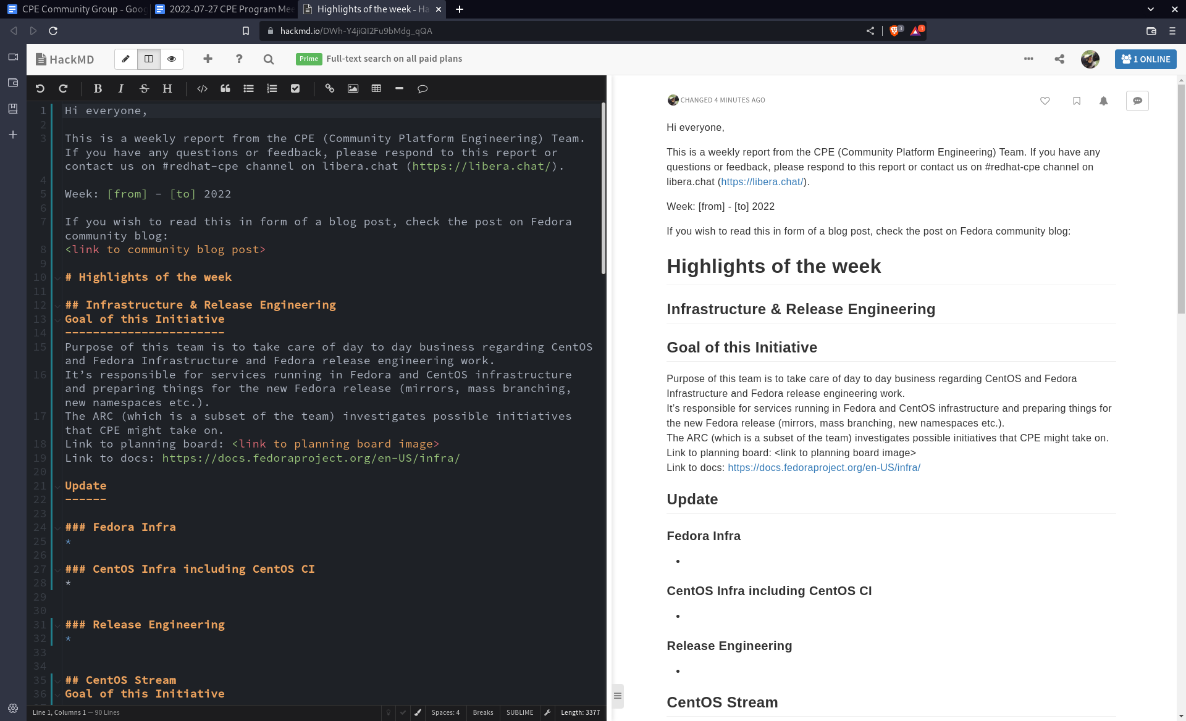
Using Fedora on Steam Deck
Working on Steam Deck
Terminal
Browser
Video meetings
Text editor
Office suite
SSH
Notes:
LibreOffice flatpak: Failed to open display, but worked later
Text editor: Tried emacs (spacemacs) and vim

Slide 15
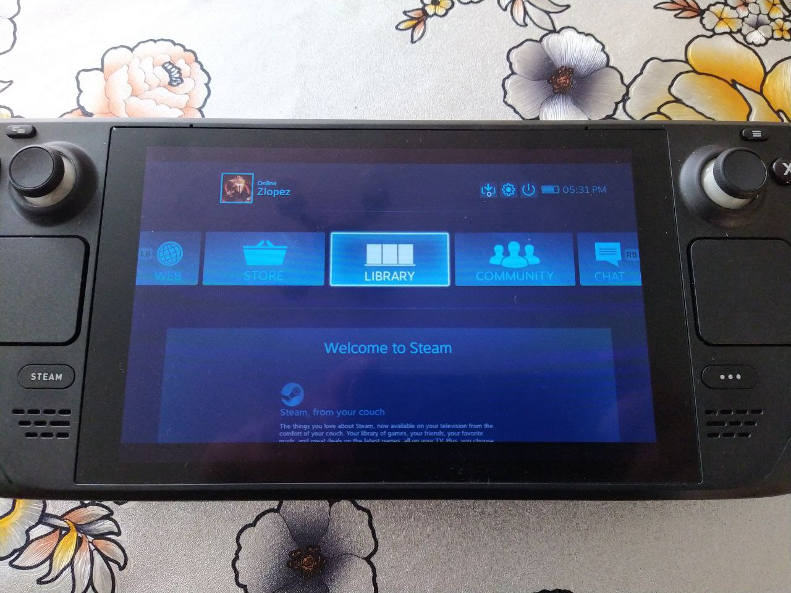
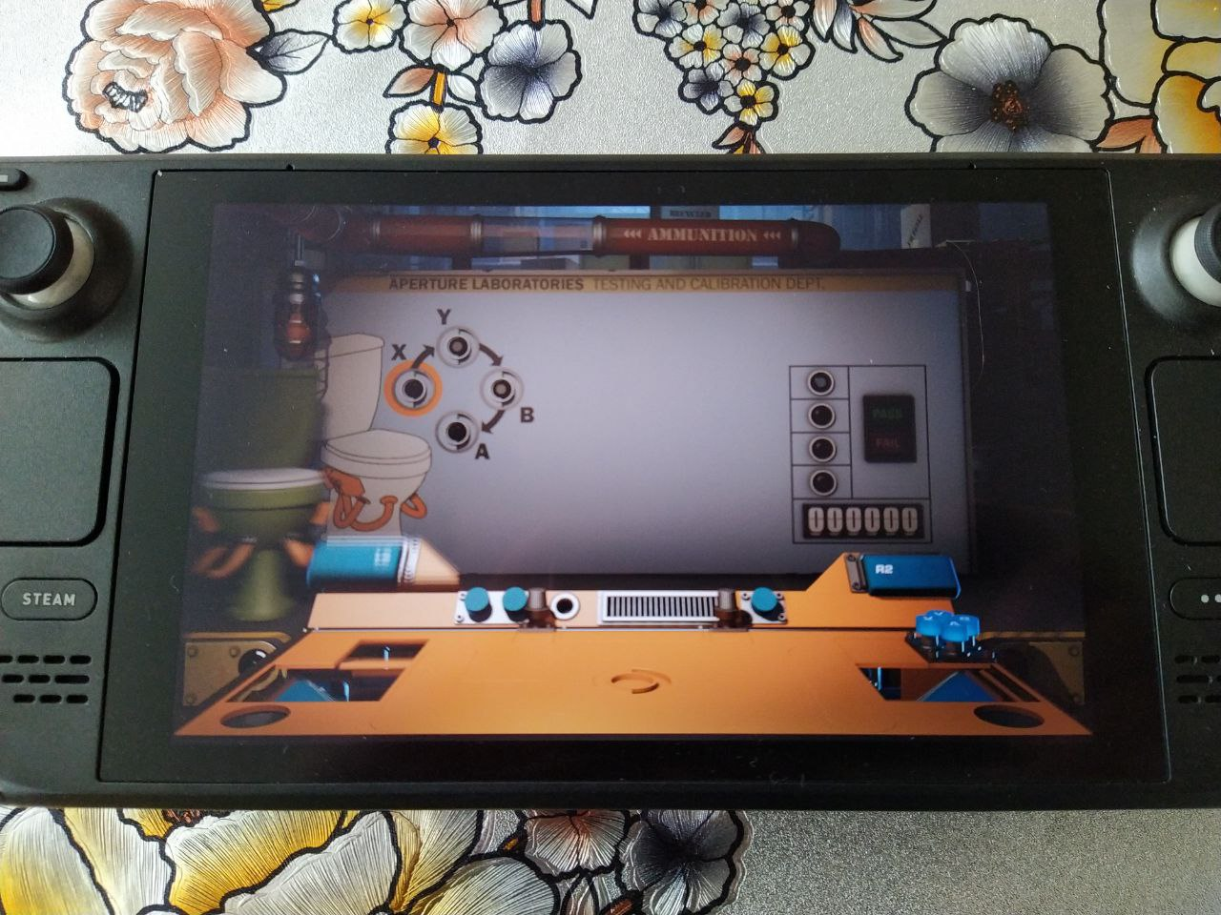
Using Fedora on Steam Deck
Gaming on Steam Deck
Steam
Big picture mode
Controller
Game performance
Gyroscope
Notes:
Steam Flatpak: No udev rules
The device was not detected as Steam Deck, but as a controller

Slide 16
Thank you!

Slide 17
References
Steam Deck
Docking station
Fedora Silverblue

